Slide 1




HR ANALYTICS

Slide 2
Project Name : HR Analytics
Mentor : Lakshmi Sirisha Pamidipati
Project Members :
Pradeebaa Gurupadmanaban
Vannalu Bhaskar Keerthana
Venkata Sai Gunishetty
Jaya Bharadwaj
Varsha Doosakanti
Aravind Reddy
Anil Kumar

Slide 3
INTRODUCTION
HR analytics is the process of using data analysis to improve HR processes and workforce performance. It involves gathering data from various HR sources, such as employee surveys and performance evaluations, and applying statistical analysis and predictive modeling to gain insights into areas like recruitment, retention, and employee engagement. By leveraging HR analytics, organizations can make informed decisions about their people strategies, align HR practices with business objectives, and ultimately optimize their human capital management practices for better business outcomes and improve overall performance.

Slide 4
STRATEGIC OBJECTIVE
The objective of this project is to conduct an in-depth analysis of employee retention and attrition rates within the organization and offer actionable insights to the HR team to enhance retention strategies. Utilizing data analysis and visualization techniques, we will pinpoint factors contributing to:
Employee turnover and attrition.
Assess the efficacy of current retention tactics.
Assess employee satisfaction levels within the organization.
Propose recommendations to bolster employee retention efforts.
Through this analysis, we aim to provide valuable insights that can guide the development of targeted retention initiatives, ultimately fostering a more satisfied and engaged workforce.

Slide 5
KPI’s
Average Attrition rate for all Departments.
Average Hourly rate of Male Research Scientist.
Attrition rate Vs Monthly income stats.
Average working years for each Department.
Job Role Vs Work life balance.
Attrition rate Vs Year since last promotion relation.

Slide 6
EXCEL

Slide 7
DATA CLEANING AND MODELLING
DATA CLEANING
DATA MERGING
Accessing Data with Power Query
Navigate to the Data tab in Excel.
Select "Get Data" and choose "From File."
Pick the Excel workbook containing your data.
Upon selecting the file and clicking "OK," Power Query Editor opens automatically.
We need to check all the column headers and data types.
We removed all duplicates from the datasets.
We removed unnecessary columns from the datasets to improve performance.
We merged both datasets, HR1 (Employee Number) and HR2 (Employee ID), into a new dataset using the "Merge as New Query" option.
Apply and close the Power Query Editor.
The Excel file now opens with the new dataset integrated.

Slide 8
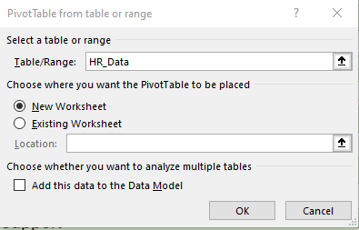
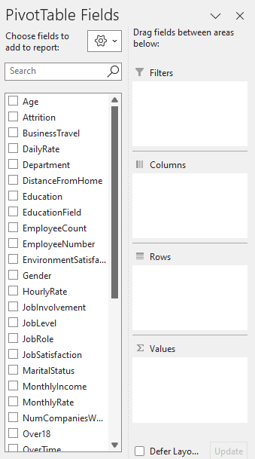
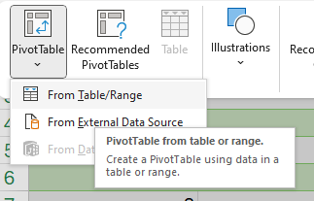
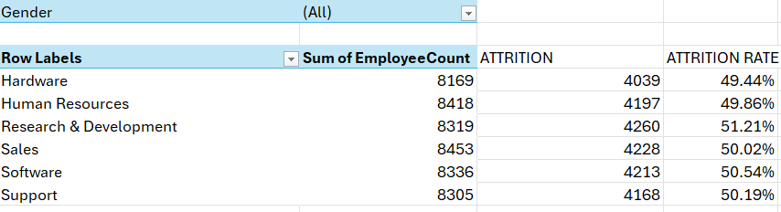
POWER PIVOT

Slide 9
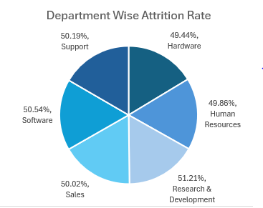


Average Attrition Rate For All The Departments
Attrition Formula:
Employees left (Attrition) / Total employees * 100

Slide 10
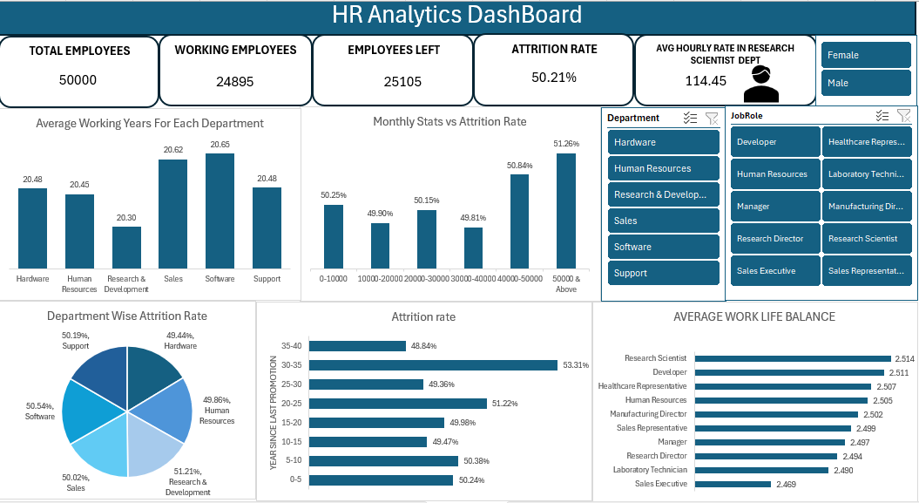

Slide 11
TABLEAU

Slide 12
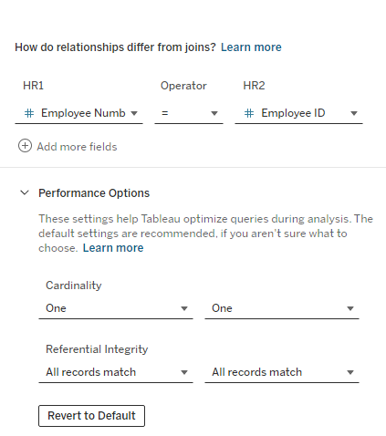
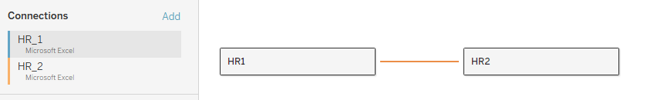
DATA MODELLING

Slide 13
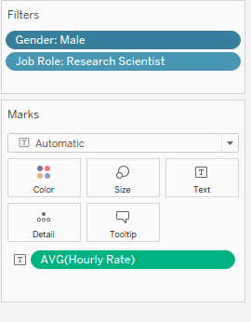
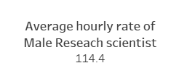
Average Hourly Rate of Male Research Scientist

Slide 14
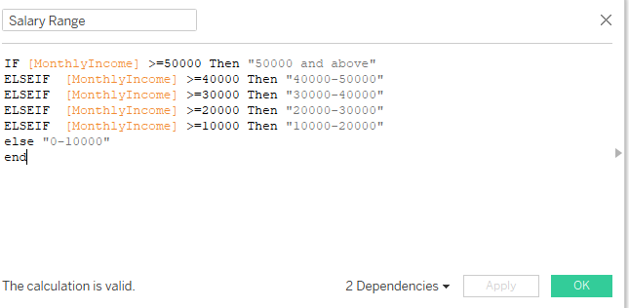
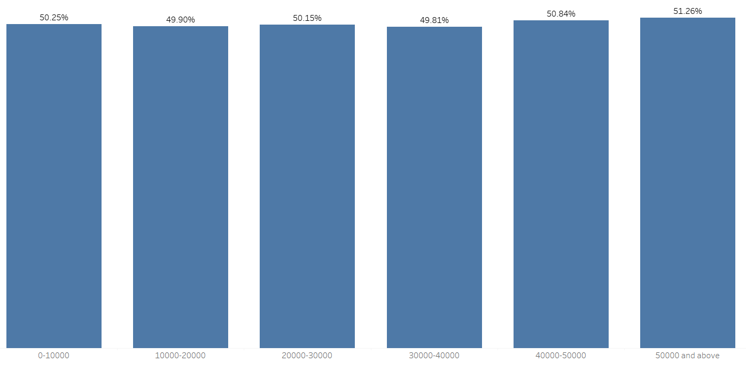
Attrition Rate Vs Monthly Income Stats

Slide 15
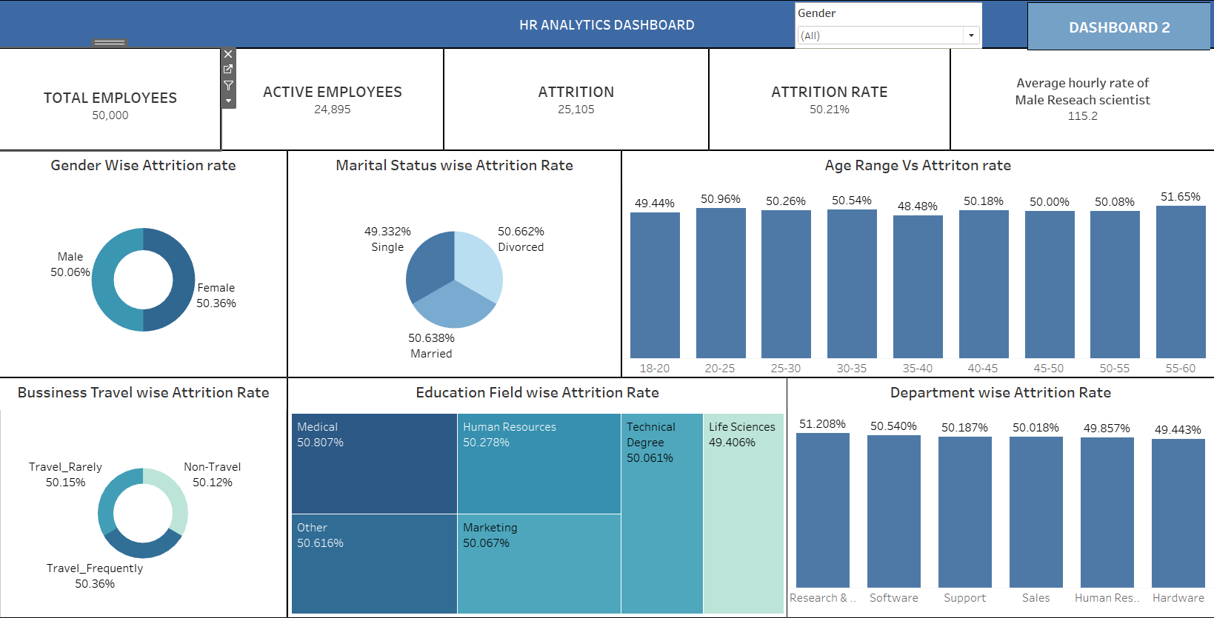

Slide 16
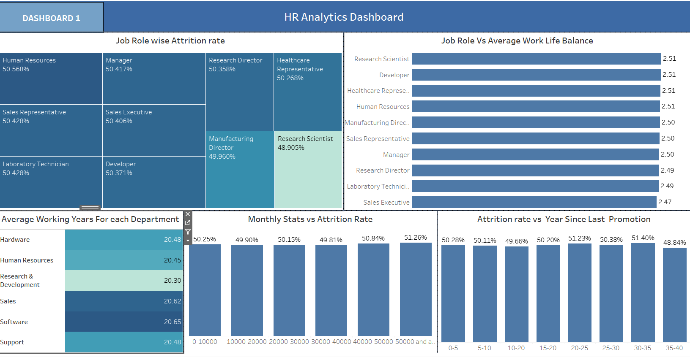

Slide 17
SQL

Slide 18
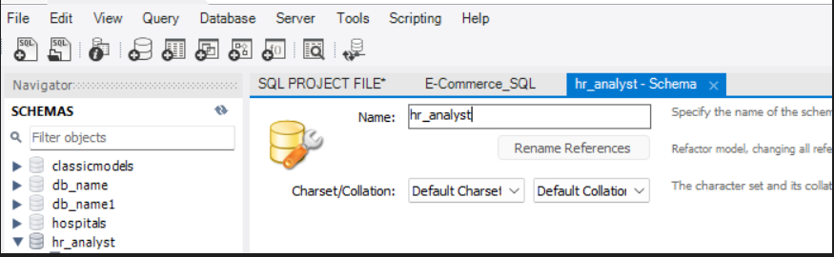
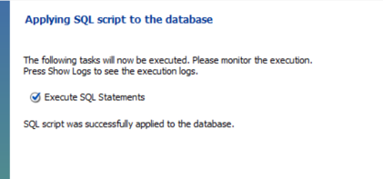
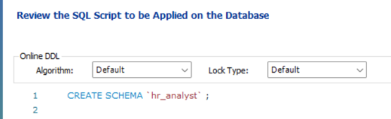
Importing Data To MySQL Workbench
First we should convert Excel into CSV file before importing into SQL.

Slide 19
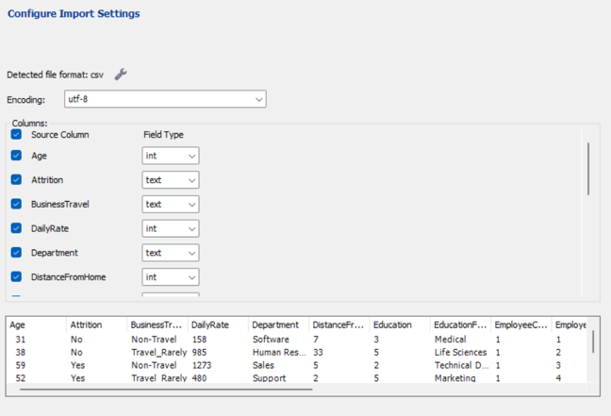
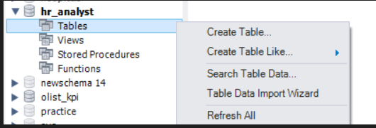
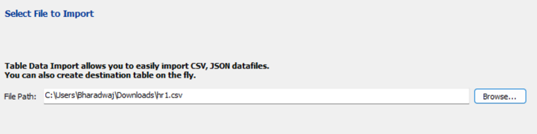
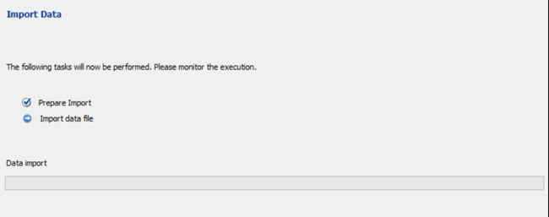

Slide 20
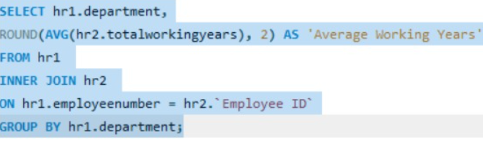
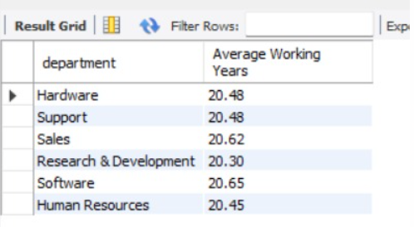
AVERAGE WORKING YEARS FOR EACH DEPARTMENT

Slide 21
POWER BI

Slide 22
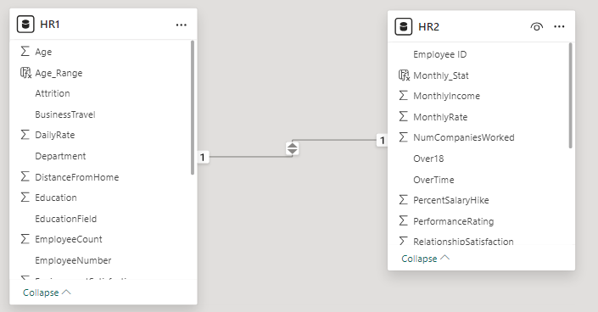
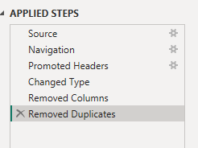
DATA CLEANING AND DATA MODELLING

Slide 23
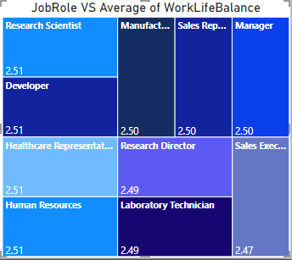
Job Role Vs Avg Work Life Balance

Slide 24
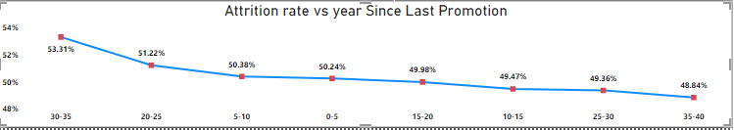

Attrition Rate Vs Year Since Last Promotion

Slide 25
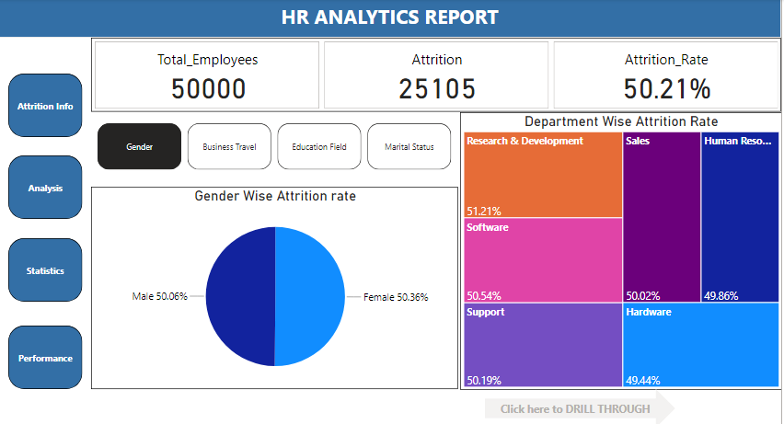

Slide 26
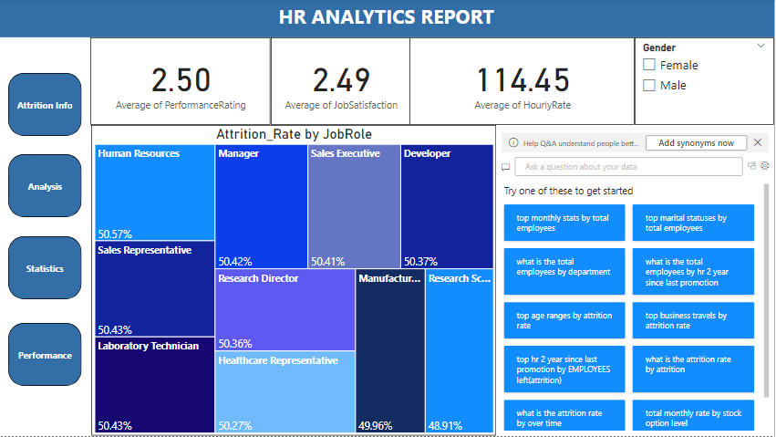

Slide 27
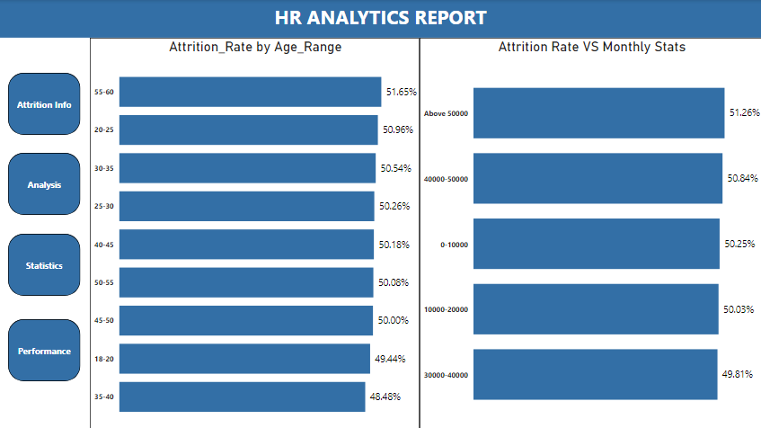

Slide 28
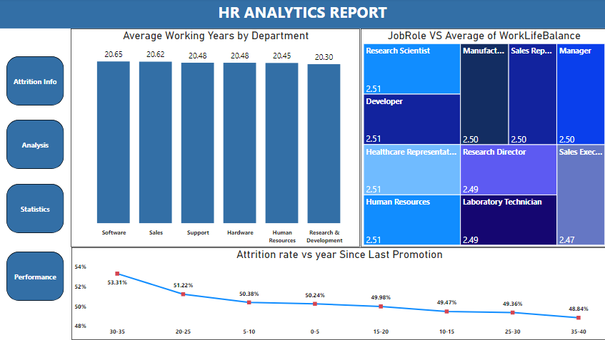

Slide 29
CONCLUSION
To tackle high attrition rate among long-distance commuters, hiring individuals who live closer to the workplace can be a solution. This reduces commute stress, enhances work-life balance, and fosters a stronger sense of community within the workforce.
By utilizing key influencer visualizations, we can pinpoint areas with higher attrition rates, aiding in targeted retention efforts to retain employees more effectively.
High attrition rate among employees with high pay may stem from workload issues or dissatisfaction with employee engagement activities. It's crucial to gather feedback about job satisfaction and create a positive work environment to address these concerns effectively.

Slide 30
THANK YOU

